Slide 1
Tracking NBA Channel Engagement Metric Trends through Web Scraping and YouTube API Analysis

Slide 2
what’s data pipeline and Why do we need it?
A data pipeline is a system or process that transports data from its origin to its destination while modifying and cleaning it along the way.
They are required because companies acquire massive volumes of data from a variety of sources, yet the data is frequently unstructured, jumbled, and stored in disparate forms.
Data pipelines automate data gathering and processing, saving time while ensuring data accuracy.
Data pipelines increase data quality by cleaning and enriching it.
Data pipelines enable the integration of data from numerous sources into a single, unified data source, resulting in improved insights and decision-making.

Slide 3
what is channel engagement metrics?
Channel engagement metrics are a collection of data elements that show how viewers connect with a specific channel on a network like YouTube.
Views, likes, dislikes, shares, comments, subscribers, and other stats are included.
They give information on how viewers interact with a channel's content and can assist content providers and marketers in understanding their target audience's behavior and preferences.
Channel engagement metrics may also be used to track the long-term performance of a marketing campaign or content strategy. By studying these indicators, content creators may learn how to optimize their material and increase audience engagement.
Channel engagement metrics will help you analyze and improve the efficacy of your channel's content strategy.

Slide 4
Objective of our project
Using web scraping and the YouTube API, we intend to analyze engagement metrics for the NBA channel on YouTube. Data fusion is used in the project to create and manage a data pipeline that comprises data ingestion, transformation, enrichment, and loading. To ensure data correctness and completeness, the pipeline contains several processes such as wrangling, grouping, deduplication, and error collecting.
To scrape and analyze data from the YouTube API, we utilize Jupyter Notebook and Python modules such as pandas, numpy, and googleapiclient. Looker data studio is also used in the project to view the data and generate reports for data analysts and data scientists. This gives insights into the NBA channel's interaction analytics on YouTube, such as views, likes, dislikes, shares, comments, and subscribers. These insights can assist content creators and marketers in better understanding their audience's behavior and preferences, allowing them to adjust their content and marketing tactics appropriately.

Slide 5
what did we do for our project?
We began with web scraping. To scrape data from many sources, including the YouTube API, we utilized Jupyter Notebook and Python modules such as Pandas and NumPy. After that, we utilized Data Fusion to create and manage our data pipeline. Data Fusion is a technology that allows us to combine data from many sources and build data pipelines. To clean and convert our data, we employed Data Fusion operators such as Wrangler, GroupBy, Distinct, Deduplicate, and Error Collector in our pipeline. BigQuery was then utilized to store our data and construct tables.
We next proceeded to visualize our data. We created reports for data analysts and data scientists using Looker Data Studio, a data visualization platform. Looker Data Studio enabled us to construct visualizations such as bar charts and line graphs to aid in our data analysis. We were able to gain insight into the NBA channel's engagement numbers and see how they evolved over time.

Slide 6
why did we made it this way?
Using Data Fusion, we were able to seamlessly merge data from several sources and develop a data pipeline. This made it easy for us to study our data and gain insights into the NBA channel's engagement stats. We also examined YouTube engagement numbers since they give useful information on how NBA channel subscribers interact with it. We can monitor how user behavior changes over time by watching these analytics and adjusting our content accordingly.
Well, using Data Fusion allowed us to easily integrate data from different sources and create a data pipeline.This made it easy for us to study our data and gain insights into the NBA channel's engagement stats. We also looked at YouTube engagement information since they give useful information on how NBA channel subscribers interact with it. We can monitor how user behavior changes over time by watching these analytics and adjusting our content accordingly.

Slide 7
Tools used
Python libraries
GCP APIs
Data fusion
BigQuery
Looker studio

Slide 8
Python libraries and GCP API’s
Pandas: for data manipulation and analysis
NumPy: for numerical operations on large arrays and matrices
Seaborn: for statistical data visualization
Google BigQuery API: for managing and querying large datasets in Google BigQuery
Google Cloud Storage API: for accessing and managing objects in Google Cloud Storage
The YouTube API in GCP is a RESTful API that provides access to YouTube data, functionality, and metadata.

Slide 9
Why Data Fusion?
Cloud Data Fusion is a cloud-native, fully managed enterprise data integration solution. Its online interface enables the creation of scalable data integration solutions without the need for infrastructure management.
The open source project CDAP powers Cloud Data Fusion.A single Google Cloud console project can have several instances. Cloud Data Fusion offers a Developer, Basic, or Enterprise instance based on your needs and budget.
Each Cloud Data Fusion instance includes a distinct, self-contained deployment that handles pipeline lifecycle management, orchestration, coordination, and metadata management. it generates temporary execution contexts for pipelines, and Dataproc is supported as an execution environment. Autoscaling is a feature of Cloud Data Fusion that automates cluster resource management for processing.
Pipelines are used to graphically construct data and control processes for extracting, transforming, blending, aggregating, and loading data from on-premises and cloud data sources. It allows for batch and real-time data pipelines, as well as replication, triggers, and plugins for various tasks.

Slide 10
Why BigQuery?
Scalability and high performance
Cost-effective pricing model
Serverless and fully managed service
Integrates with various data sources and BI tools
Supports real-time data analysis and streaming data processing
Automatic backups, high availability, and security features.

Slide 11
Why Looker studio?
Looker Studio provides a unified platform for data exploration, visualization, and collaboration, enabling faster and better-informed decision-making.
Data visualization using Looker involves creating dashboards and visualizations that allow users to gain insights and make data-driven decisions, with the data sourced from BigQuery, a fully-managed, serverless data warehouse solution provided by Google Cloud Platform (GCP).

Slide 12
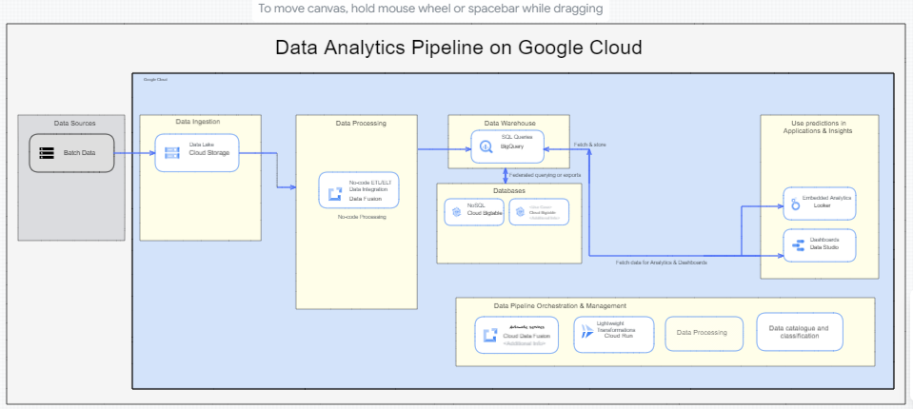
Our Data architecture

Slide 13
Stages of our project
The project involved the following stages:
Source systems: Identify the data sources, including NBA channel engagement metrics from web scraping and YouTube API analysis.
Landing area: Create a landing area to store the raw data.
Cleansed/Enriched: Cleanse and enrich the data to ensure there are no missing or null values.
Deduped conformed: Remove duplicate records and conform the data to a standard format.
Data processing: Process the data to derive insights and trends.
Data catalogue & Classification: Catalog and classify the data.
Data storage: Ingest the data into GCP and build a batch ETL pipeline using Data Fusion.
Data visualization: Store the data in BigQuery and use Looker and Data Studio to create a report for data analysts and data scientists.

Slide 14
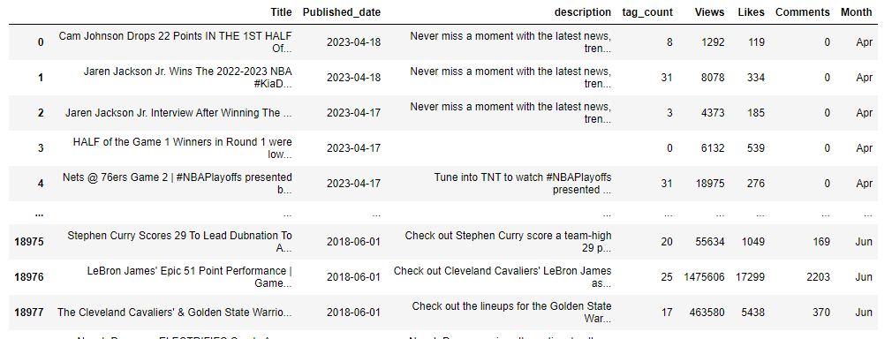
Data Sources
The data sources for this project were NBA channels on YouTube. We collected data using Python web scraping libraries and YouTube API. The data included engagement metrics such as likes, views, comments, and tag count, as well as video titles, descriptions, and lengths.

Slide 15
Data Cleaning and Processing
We then cleaned and enriched the data to ensure there were no missing or null values. We removed duplicates and conformed the data to a standard format. This was done to ensure that the data was accurate and could be used for analysis.
We processed the data to derive insights and trends. We used Python libraries like Pandas, Numpy, and Seaborn to analyze the data. We also used various statistical techniques to identify patterns and correlations in the data.

Slide 16
Data Catalogue, Classification and Storage
We cataloged and classified the data using GCP's Data Catalog. We created a schema for the data and classified it into various categories. This was done to ensure that the data was easily accessible and searchable.
We ingested the data into GCP and built a batch ETL pipeline using Data Fusion. The data was then stored in BigQuery, which allowed for easy visualization and analysis.

Slide 17
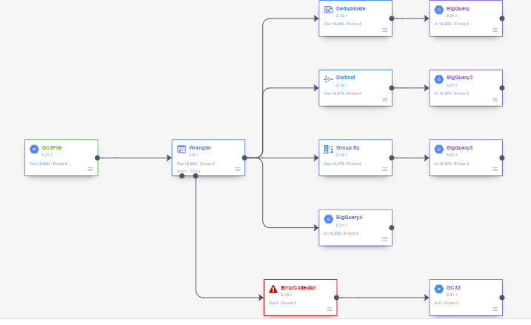
Our pipeline

Slide 18
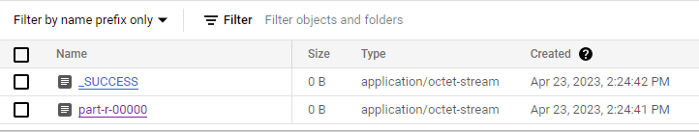
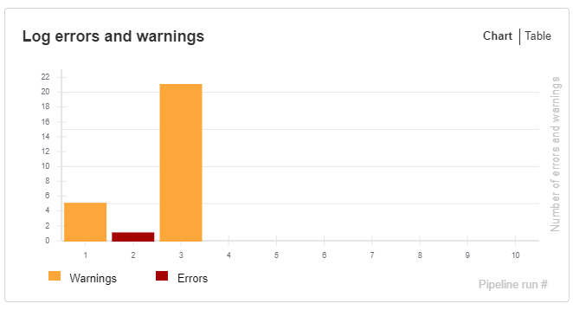
Pipeline summary and log charts

Slide 19
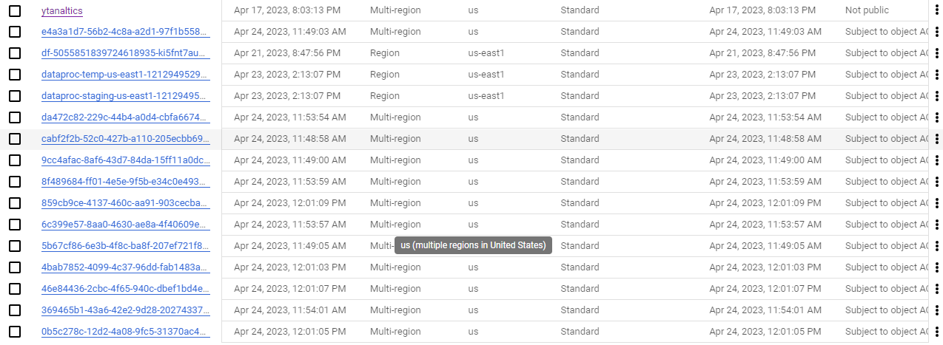
load jobs logs in gcp cloud storage

Slide 20
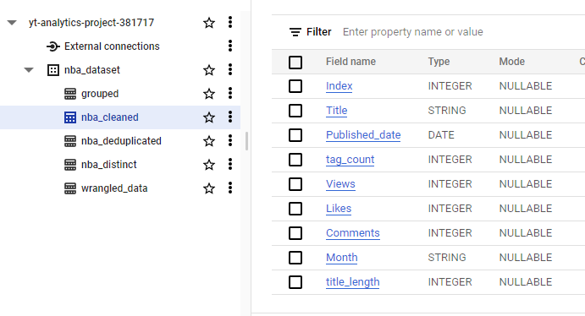
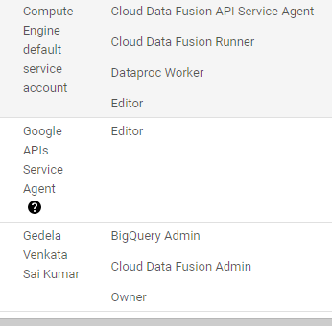
Big query tables and IAM roles

Slide 21
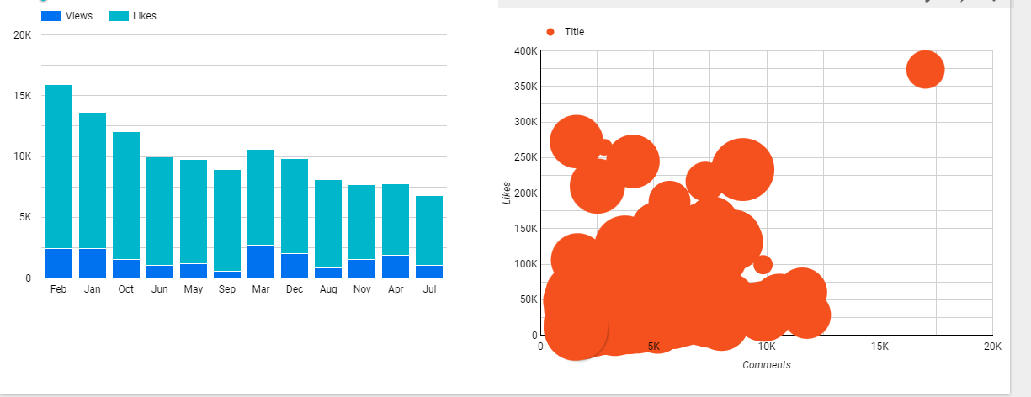
Data Visualization
We used Looker and Data Studio to create a report for data analysts and data scientists. The report included various visualizations and dashboards that provided insights into engagement metrics, topics, and regions. This made the data more accessible and actionable for the end-users.

Slide 22
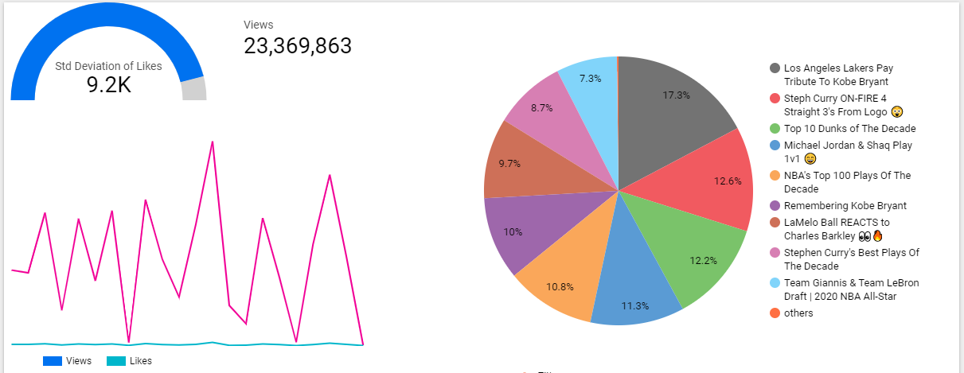
Dashboard

Slide 23
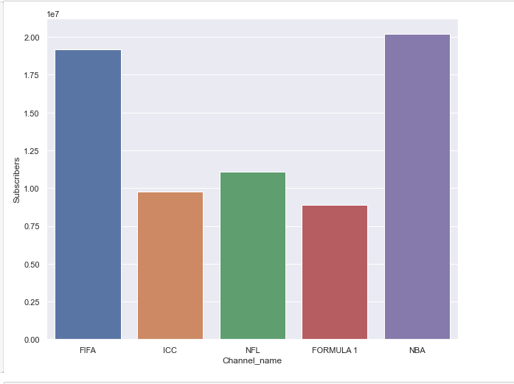
Total subscribers

Slide 24
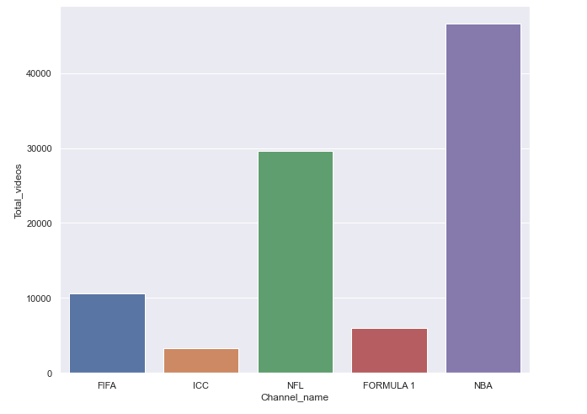
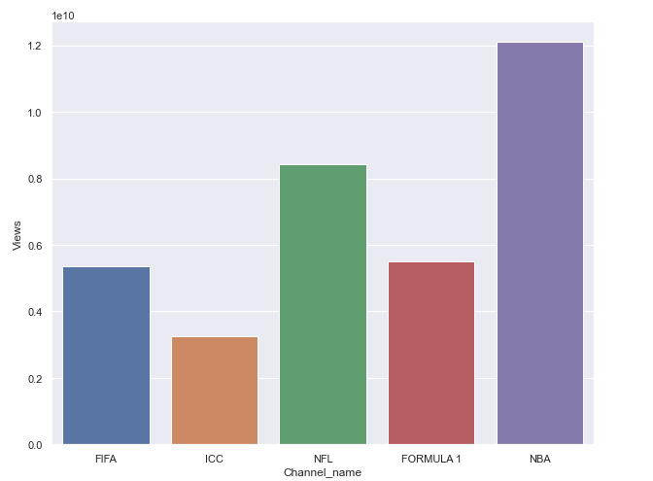
Sports channels and their total views

Slide 25
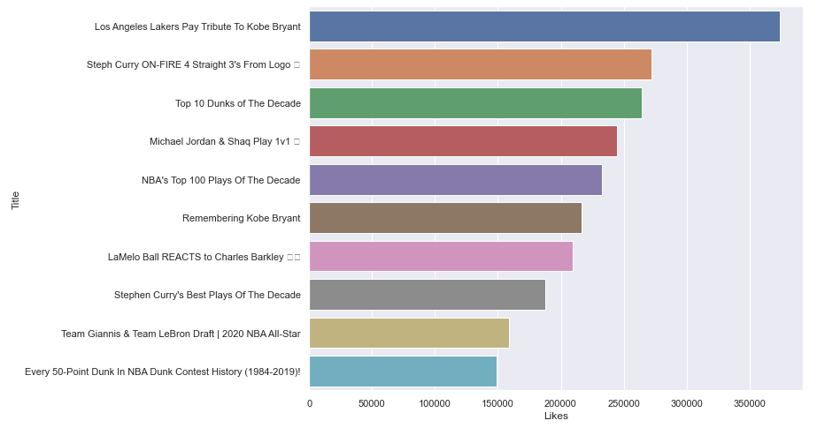

Slide 26
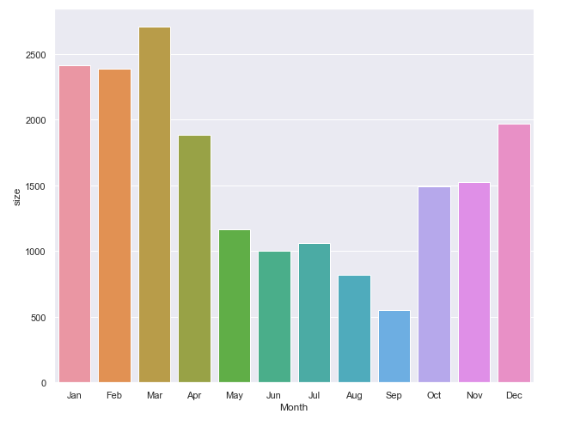
Videos according to month

Slide 27
Insights
Based on the data that was collected and processed, we derived several key insights:
The most engaged sports channels on YouTube were identified.
The most popular topics discussed on NBA channels were identified.
The correlation between engagement metrics and channel growth was identified.
Engagement metrics varied across different regions.

Slide 28
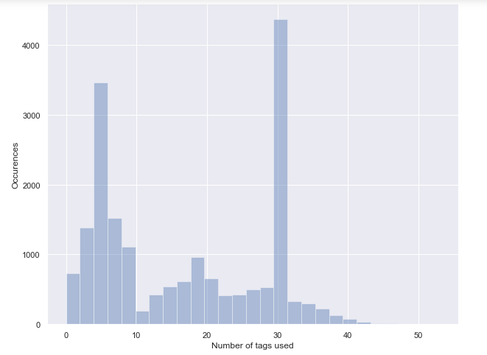
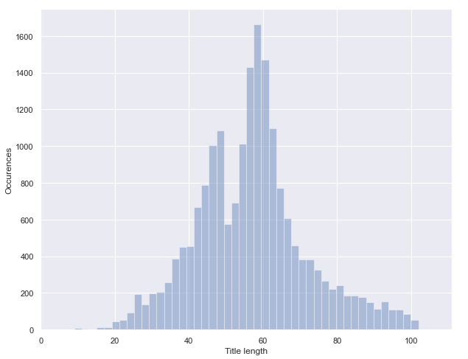
Insights regarding tags

Slide 29
what were some lessons learnt or challenges encountered
Some lessons learned and challenges encountered during this project. For example, we had to make sure we were scraping the data correctly and efficiently. We also had to make sure we were using the correct metrics and interpreting them correctly. However, through these challenges, we were able to learn a lot and improve our analysis.
The significance of data quality and accuracy. We had to ensure that we were scraping and processing data appropriately. We also have to be aware of biases in our study and avoid forming conclusions without supporting facts.

Slide 30
Using Wrangler and Distinct function in data fusion
Complexity: Although Data Fusion is a strong data integration tool, it can be difficult to set up and configure for people unfamiliar with the platform.
Limited customization: Although Data Fusion includes a number of pre-built connections and transformations, there may be times when users want new transformations or connectors that are not easily accessible.
Limited support for certain data sources: Data Fusion supports a wide range of data sources, although there may be cases where some data sources are not supported, forcing customers to seek alternate solutions.
Limited infrastructure control: Because Data Fusion is a managed service, users have little influence over the underlying infrastructure. This might be difficult for users that demand custom setups or optimizations.
Cost: While Data Fusion is a low-cost option for many data integration needs, it can be expensive for those with big or sophisticated data integration needs.

Slide 31
Assigning IAM Roles
Role creep happens when people acquire too many roles over time, causing confusion about the rights a user has and what they are accountable for.
Role explosion occurs when there are too many roles and it becomes difficult to manage and allocate them.
In certain circumstances, roles inherit permissions from other jobs, making it difficult to determine who has access to what.
Role naming conventions: Poorly titled roles can cause confusion and make determining which responsibilities are acceptable for particular users difficult.
Overprivileged roles: When roles have too many rights, users can access more than what is required for their job tasks, which can provide a security risk.
Inadequate oversight: Without effective oversight, it might be difficult to detect when people are allocated responsibilities they should not have, potentially resulting in security breaches.

Slide 32
Creation of tables
One of the most difficult aspects of designing regular tables is controlling and optimizing the table's storage space. As the table increases in size, it becomes more complex to query and manage, and performance concerns may arise.
Partitioned tables, on the other hand, can provide various advantages over conventional tables, including faster query efficiency and simpler handling of huge datasets. Partitioned tables separate data into smaller, more digestible portions depending on certain criteria like date or area.
One of the main solutions to the storage space challenge with partitioned tables is that each partition can be stored separately, allowing for more efficient use of storage resources. Additionally, partitioning can help with query performance, as it allows the database to only access the relevant partitions when processing a query, rather than scanning the entire table.

Slide 33
The undercurrents of our project lifecycle
Security: Our project prioritized data security and ensured that the data pipeline and analytic tools were safe. The project employed safe data storage alternatives like BigQuery and made sure the API key for the YouTube API was kept private.
Data management: Our project used a data pipeline to manage and process data from various sources, ensuring that the data is transformed and cleaned before it is loaded into the database. The project also used Looker data studio to visualize and manage the data, creating reports for data analysts and data scientists.

Slide 34
Contd…
DataOps: DataOps concepts were utilized in our project to automate the data pipeline and guarantee that data was handled efficiently and properly. Wrangler, GroupBy, Distinct, Deduplicate, and Error Collector were also used to clean and enhance the data.
Data architecture: While building the data pipeline, our team studied data architecture to ensure that the data is kept in a form that allows for quick access and analysis. BigQuery was also employed as a cloud-based data warehouse in the project, which provides a scalable and cost-effective alternative for data storage.

Slide 35
Contd..
Orchestration: An orchestration tool was utilized in our project to handle the many phases of the data pipeline, ensuring that data is processed in a timely and effective way. Data Fusion was utilized as an orchestration tool in the project, which provides a visual interface for designing and maintaining data pipelines.
Software engineering: To guarantee that the data pipeline and analytic code are efficient, maintainable, and scalable, we applied software engineering concepts such as code reusability, modularity, and version control. To scrape and analyze data from the YouTube API, the project employed Python packages such as pandas, numpy, and googleapiclient. Jupyter Notebook was also utilized in the project to write and test the analytic code.

Slide 36
Conclusion
Finally, web scraping and API research can give important insights into social media engagement metrics such as YouTube. These insights may be made accessible and useful for data analysts and data scientists by utilizing GCP and data visualization tools. This study demonstrates the significance of data cleansing, processing, and visualization in gaining insights from data. Thank you for your time, and I would be happy to answer any questions you may have.

Slide 37
Target audience for this project
Our project's target audience comprises data analysts and data scientists interested in understanding engagement numbers for the NBA channel on YouTube. The initiative gives information into the channel's viewers' behavior, preferences, and engagement with its material, which may be utilized to improve the channel's content and marketing tactics. This initiative can also aid content creators and marketers that want to analyze engagement numbers for their YouTube channels. They may utilize the project's insights and analytical methodologies to better their content and marketing tactics.
Our project's future research might include extending the study to include more engagement indicators or examining engagement data for other YouTube channels. The project may also be developed to include sentiment analysis of comments and a review of engagement metrics across other social media sites. Another potential future project goal is to automate the data processing and analysis in order to deliver real-time insights into engagement metrics.

Slide 38
References
Mike Thelwall (2018) Social media analytics for YouTube comments: potential and limitations, International Journal of Social Research Methodology, 21:3, 303-316, DOI: 10.1080/13645579.2017.1381821
Manko, B. A. (2023). Video advertising: Using YouTube analytics for the target audience. Journal of Information Technology Teaching Cases, 13(1), 77–81.
Tackett, Sean MD, MPH; Slinn, Kyle RN, MEd; Marshall, Tanner MS; Gaglani, Shiv MBA; Waldman, Vincent PhD; Desai, Rishi MD, MPH. “Medical Education Videos for the World: An Analysis of Viewing Patterns for a YouTube Channel.”
Cunningham, S., Craig, D., & Silver, J. (2016). YouTube, multichannel networks and the accelerated evolution of the new screen ecology. Convergence, 22(4), 376–391.
“YouTube Analytics Using Google Data Studio” Krishna Bhargava Anantharamaiah

Slide 39
Thank you

